Slide 1
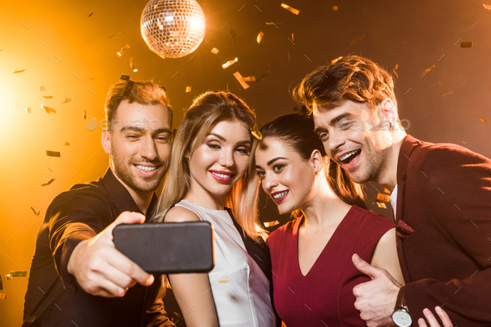
I am so happy to see you
The last week was hell for me
Some people here saw me on Wednesday
I had the entire first year
I had the entire second year
Can the data & ai people not spoil my magic trick

Slide 2
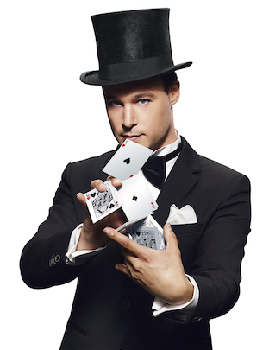
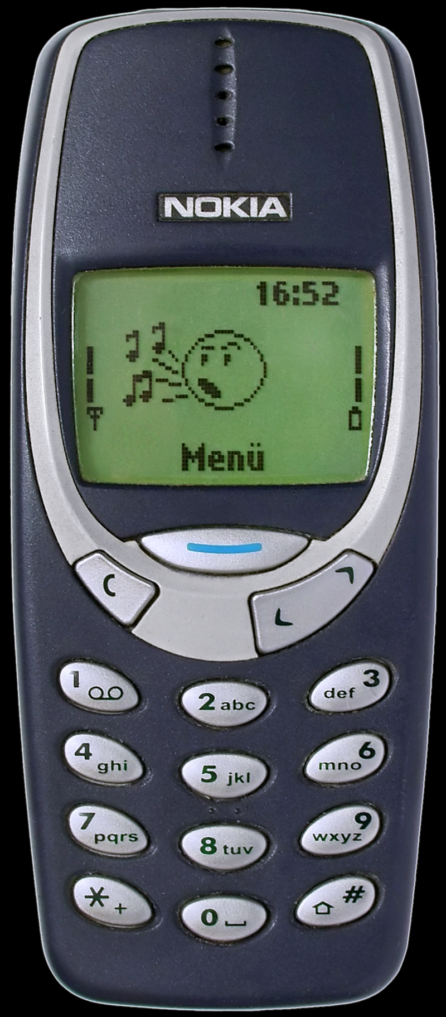

Slide 3
I have a huuuuuge surprise during presentation session (6th, week 7)

Slide 4
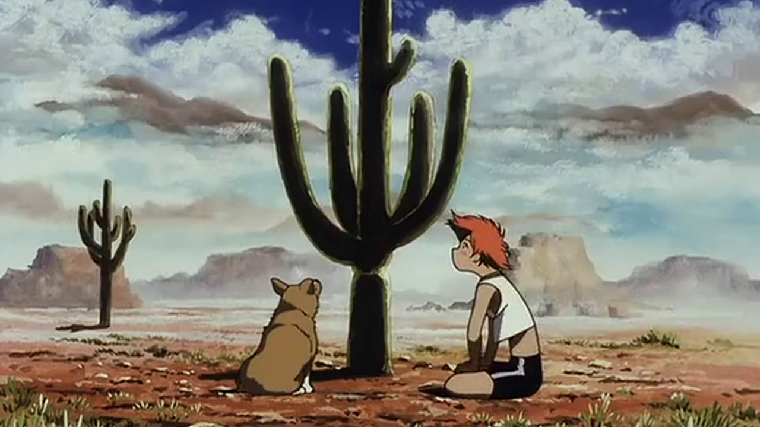
How was your summer?

Slide 5


Slide 6
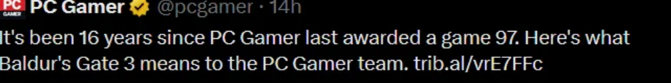
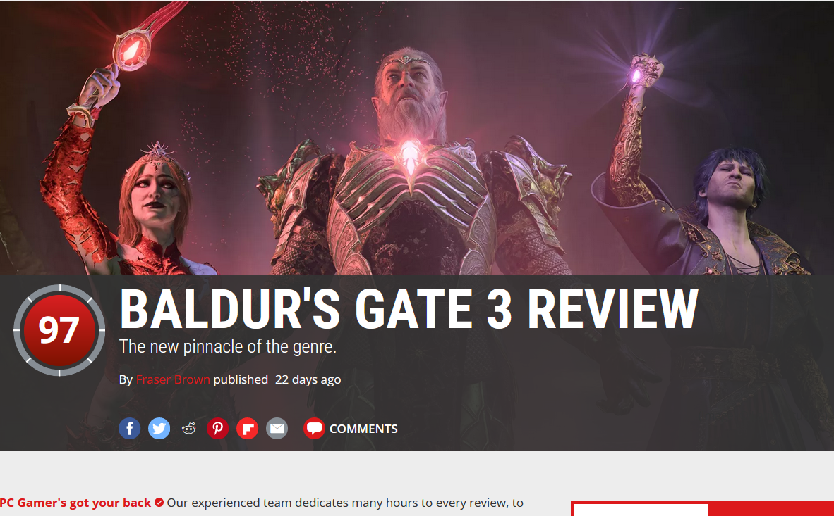
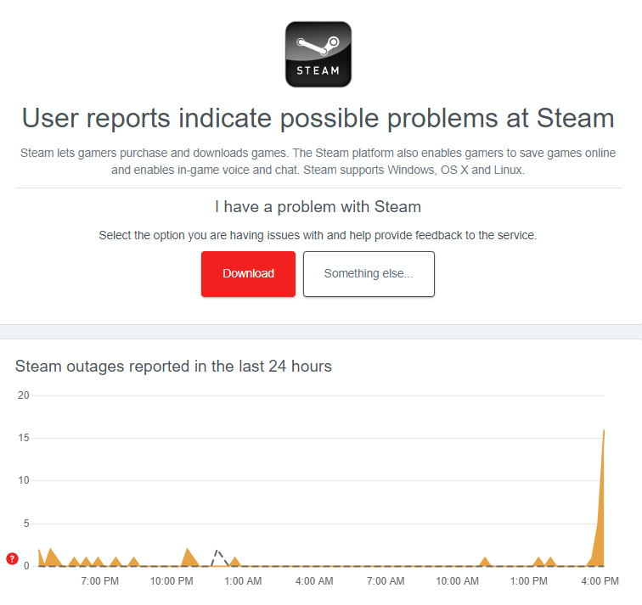
(For a day) 8th best game of all time (metacritic)
Shared 1st spot (with Disco Elysium) for best game all time on PC
At launch, 24% of people playing a game on steam were playing BG3

Slide 7
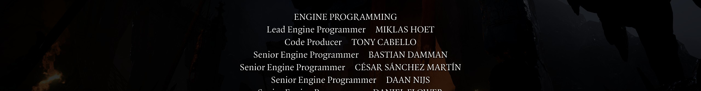
Am I bragging?
Yes, …. Kinda
Writers and artists made this game
But I still *NEED* to be proud
And so do you

Slide 8
Be proud of your s**t
“Quality is what you do if nobody is looking”
Some (or even most) of your work will never be used
Some of your work you will hate
Being proud is what works for me
It ensures you will do what needs to be done

Slide 9
Questions?

Slide 10
PS
“Send me an email” if you think my slider are unclear, and you know how they could be better

Slide 11
SD + DE
2023
Mobile Applications
Week X : Title week
Daan Nijs / Dries Decuyper

Slide 12
Introduction
Is there anyone here that hasn’t had me before?

Slide 13
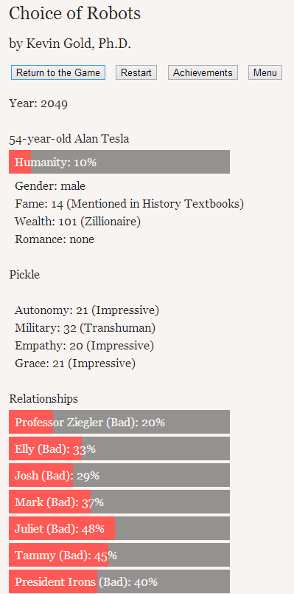
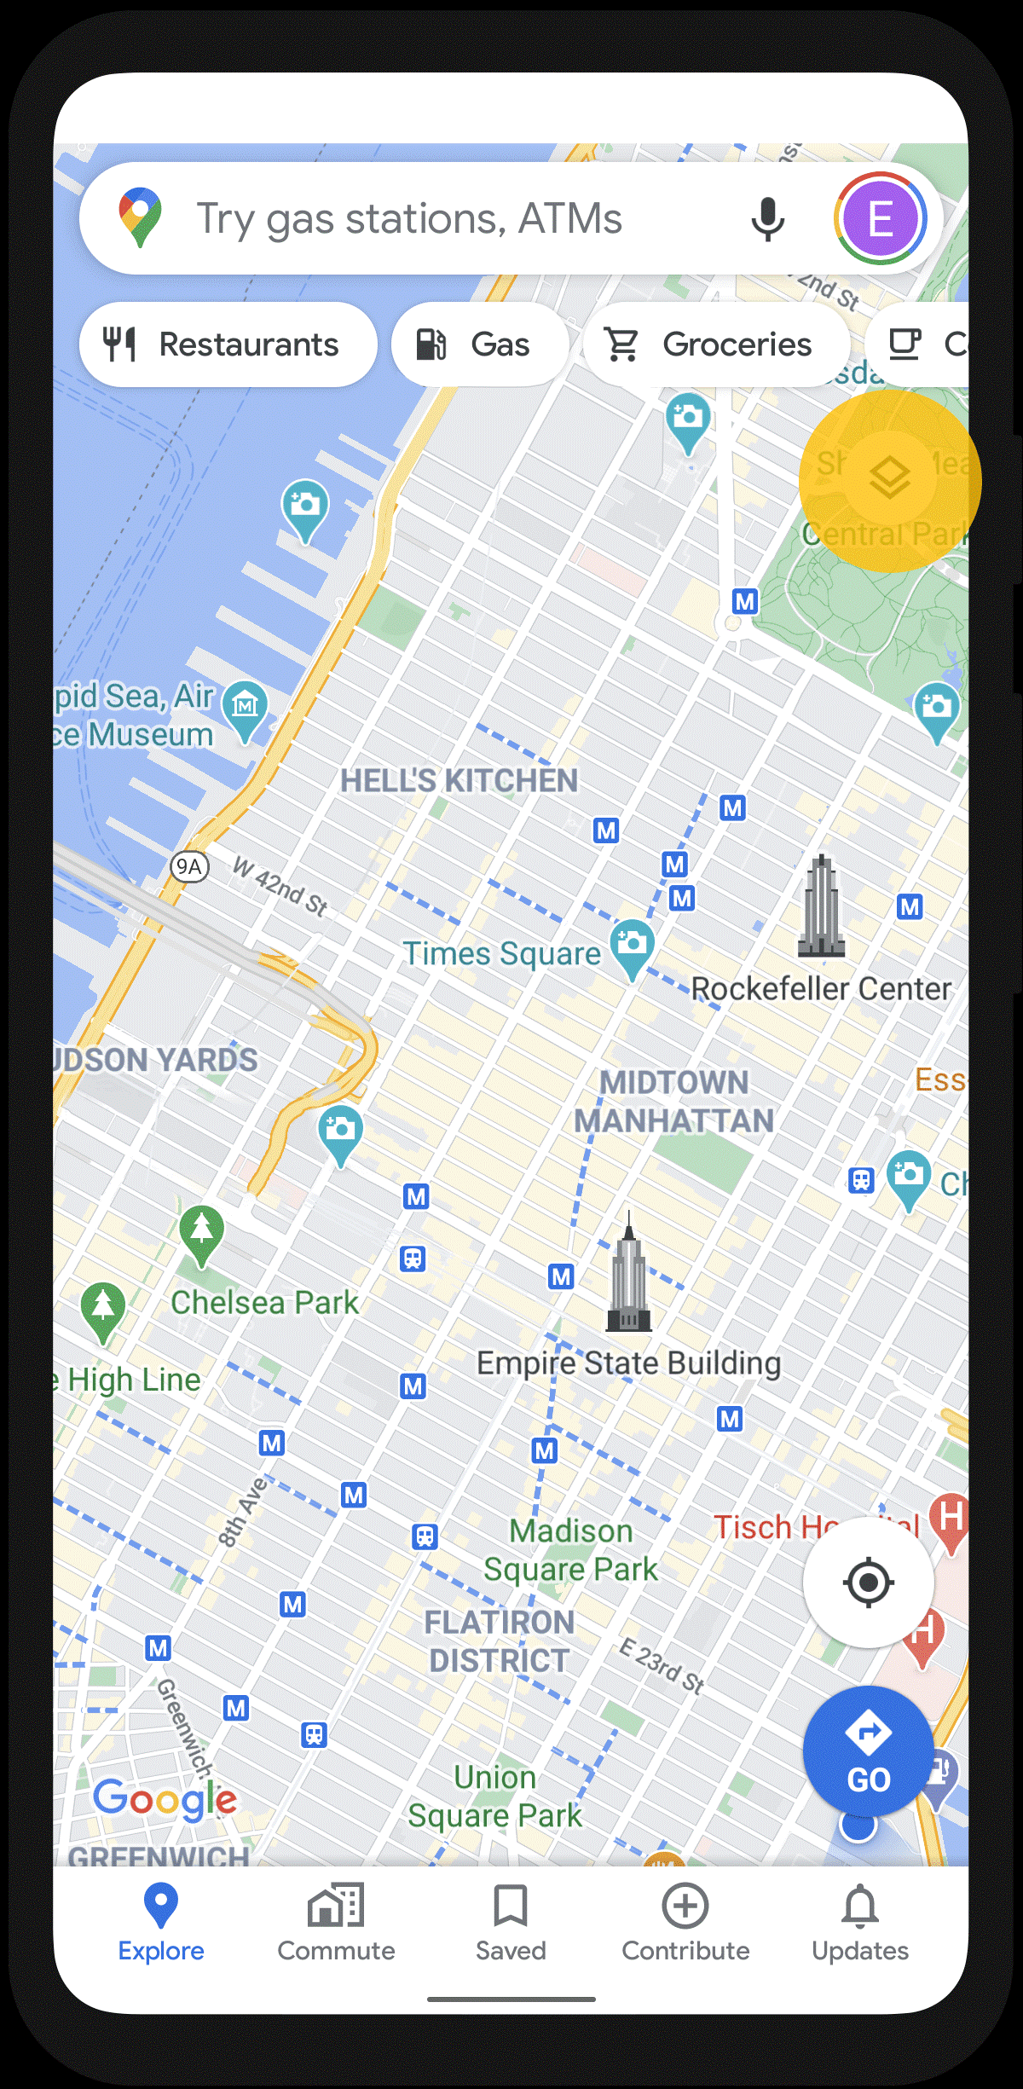
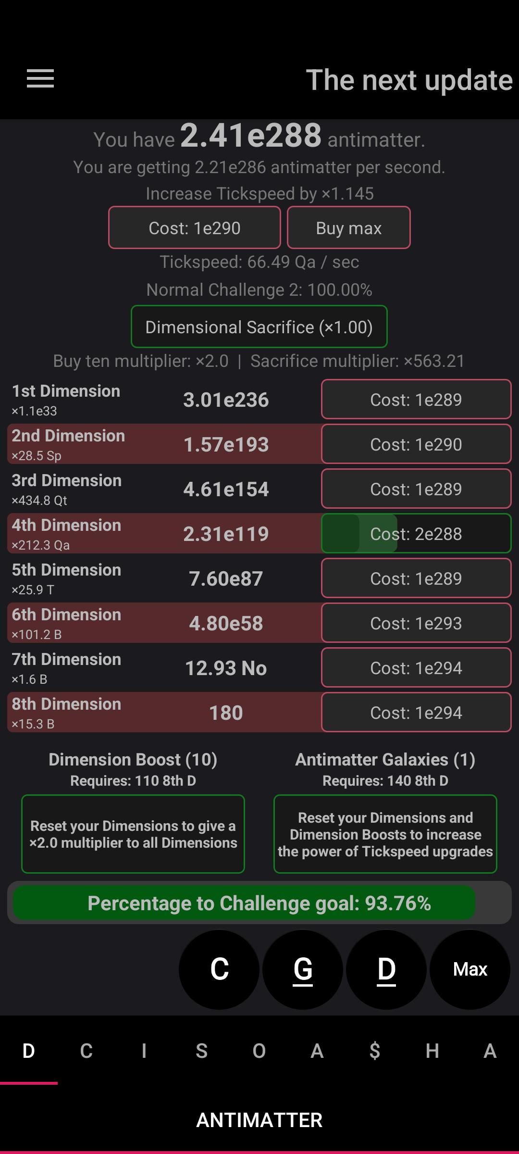
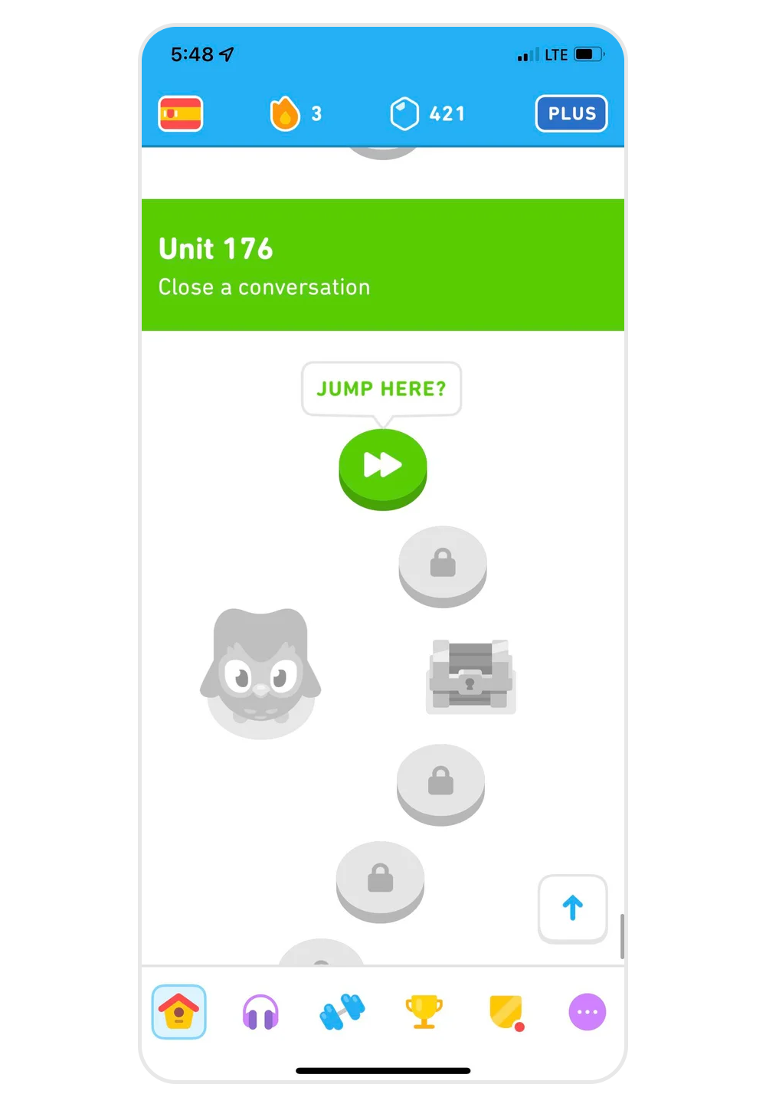
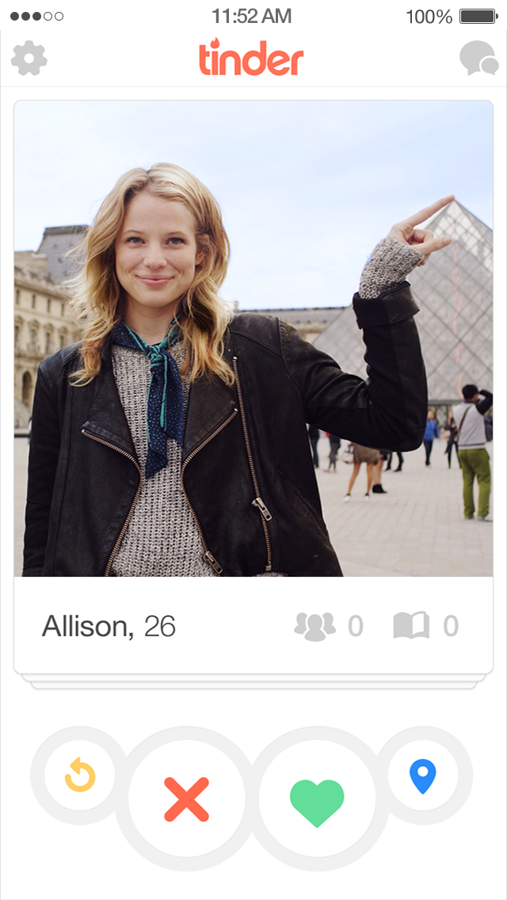
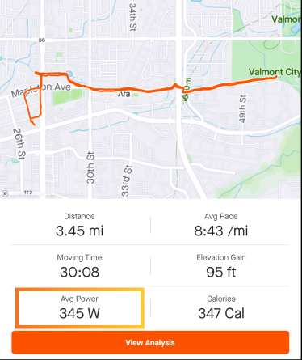
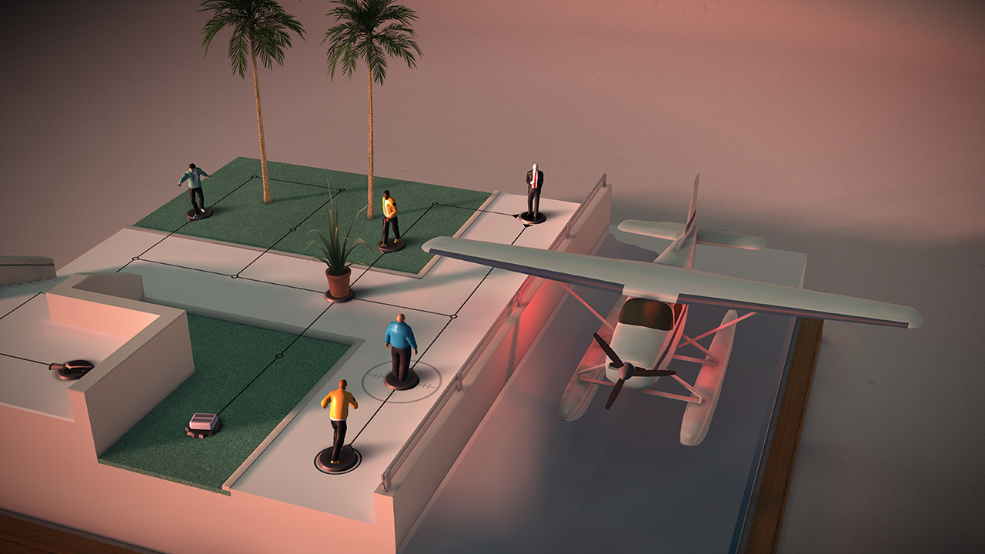

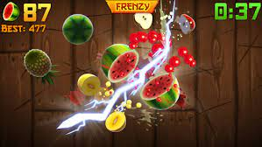
Last week
We tried out a lot of mobile games

Slide 14
This week
Information about the course (evaluation, deadlines, deliverables)
History of mobile applications
Information about pitch document deliverable
High level design of mobile applications

Slide 15
Course planning : context
Week 1 No class (this was last week)
Week 2 → Introduction, design, pitch ←
Week 3
Tech stack, information about technologies
You can submit a draft pitch with feedback : deadline CEST 20:00 2023/10/06 (6th of October, 8pm)
Week 4
DEADLINE PITCH CEST 20:00 2023/10/13 (13th of October, 8pm)
Emulation, accessibility
…..
Week 7 Presentation workshop / class
Week 8 Die (“sterven”) before the big aula. It’s not mandatory to do it in the aula. More info later
…..
Oral defence

Slide 16
Presentation
Is a big thing, I hope more than 100 people will look at you doing it
1 minute
Don’t worry about it
It’s not mandatory
You can do it just for me
But I really hope 90% of you want to die
I do it all the time

Slide 17
Evaluation
Your pitch
Your presentation
Your report
Your defence (your app, it’s part of above)
I will clarify how much point for each, if I haven’t posted it before next class let me know

Slide 18
This is not the old mobile applications
The old one was 3 credits
This one is 6 credits
In the old one you made an app and defended it
In this one you also design, pitch, and present it

Slide 19
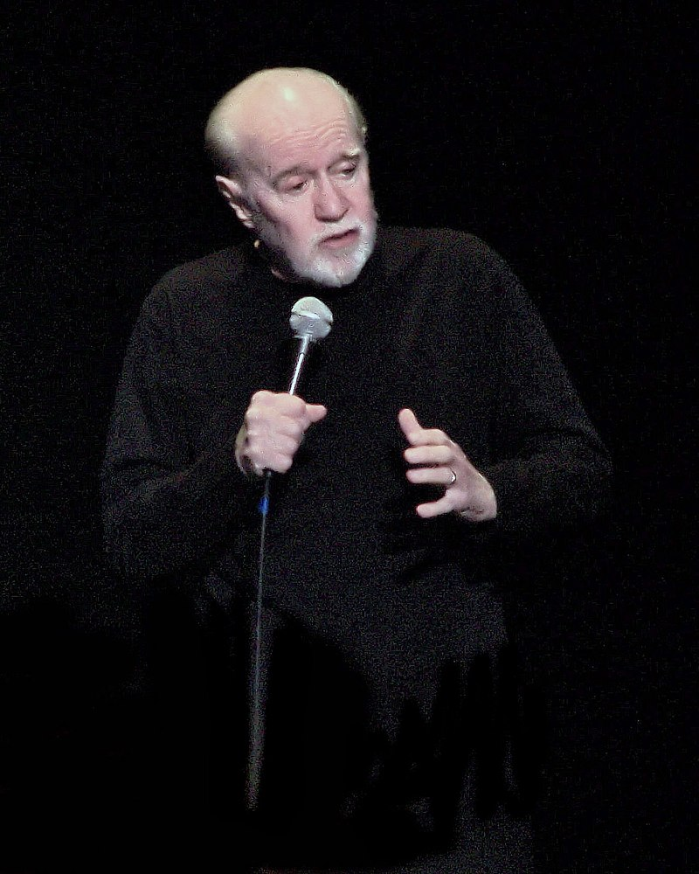
My class is not compulsory Mijn lessen zijn niet verplicht

Slide 20
Pitch
Deadline : CET 20:00 2023/10/13
Feedback deadline : deadline CET 20:00 2023/10/06
Focus on your pitch!
CET = Leuven time, Central European Time
I also need to do Toledo so you can hand in your pitch

Slide 21
I will upload examples
Bad vs Good
If you don’t have it by CET 20:00 2023/01/10, please let me know by email

Slide 22
Scope
This is what I check in the pitch
Implementing your app should take about 2 weeks 9-5

Slide 23
Group work
Maximum 4 people
Needs to be bigger
Think of “materialenbank”

Slide 24
Your pitch
Description
Statement of work
Risks
Exactly 1 A4 , minimum 300 words

Slide 25
Description
A short description of your app, about 100 words, you should add images.
“Our app is tinder , Internder. The profile pictures are replaced with logo's of technologies, picture of the city it is in, the manager, the office, etc... There is no "match", but students can export a list of the internships they're interested in. The idea is a fun way to narrow down the list of potential places to apply for.”

Slide 26
Statement of work
A list of need to haves
Need to have : without this thing the app doesn’t work
As many to fill half your time
Need to have : find a route through a city
Nice to have : show restaurants on the map

Slide 28
Inspiration
We’re going to look at some apps

Slide 29
Tinder
Good
Bad
Evil

Slide 30
Duolingo
Good
Bad
Evil

Slide 31
Super hexagon
Good
Bad
Evil

Slide 32
Strava
Good
Bad
Evil

Slide 33
Google maps
Good
Bad
Evil

Slide 34

Fruit ninja
Good
Bad
Evil

Slide 35
Others?
Good
Bad
Evil

Slide 36
Other topics
Camera
Horizontal versus Vertical
Gyroscope

Slide 37
Make something you can be proud of

Slide 38
Live feedback
Does anyone already have an idea of what they want to make?

Slide 39
Next week
Tech stack
History of mobile platforms

